Slide 1
Announcements
Next week is spring break
No class
After that we have one more night lab
Mid-Semester Reminder
Please do not use AI to complete your labs
I can tell
I have had to make one report so far (both my classes combined) (better than last semester)
But there are more I have suspicions about
Next class is the last time to turn in any lab from the first half of the semester
Any lab from today or earlier will not be accepted after that

Slide 2
Magnitudes and Stellar Brightness

Slide 3
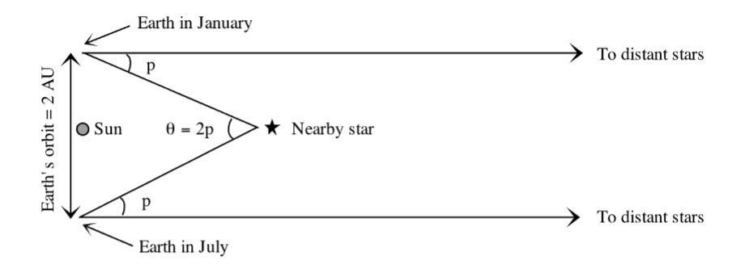
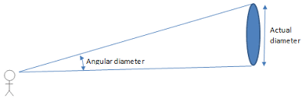
Review From Previous Labs (Parsecs)
A unit of distance, not time
Equal to 3.26156 ly
Comes from the apparent movement (parallax) of the object
1 pc is the distance to an object with a parallax angle of 1 arcsecond

Slide 4
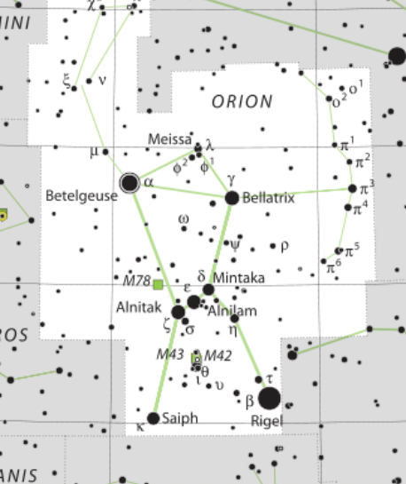
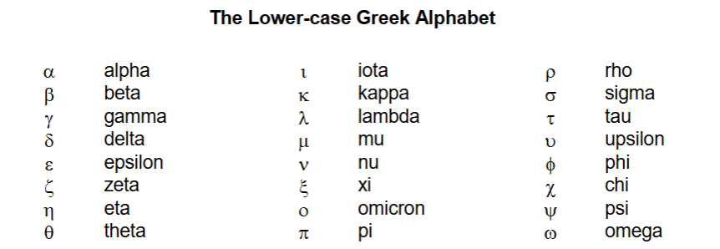
Review From Previous Labs (Stellar Nomenclature)
Proper name is a Greek letter and the name of the constellation
Usually, the brightest gets α, second brightest gets 𝛃, etc…
But there are exceptions

Slide 5
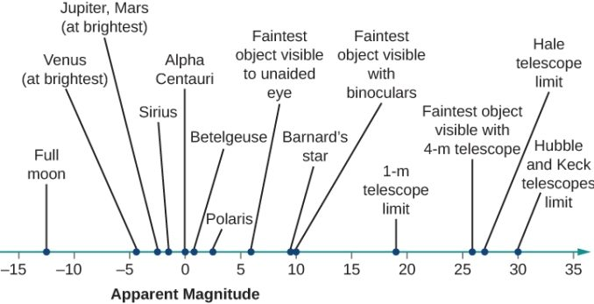
Review From Previous Labs (Apparent Magnitude)
Previously I mentioned magnitude - how bright a star is
More specifically we discussed “Apparent Magnitude”
This is how bright things appear to be - further objects look less bright than they actually are
Important details:
Inverse Scale
Smaller = Bigger
Logarithmic Scale
A difference of 1 magnitude is a difference of 2.512 times in terms of brightness

Slide 6
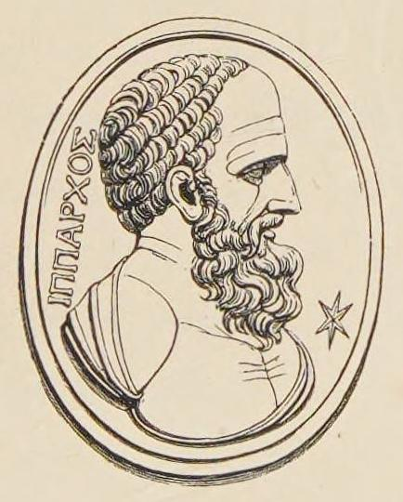
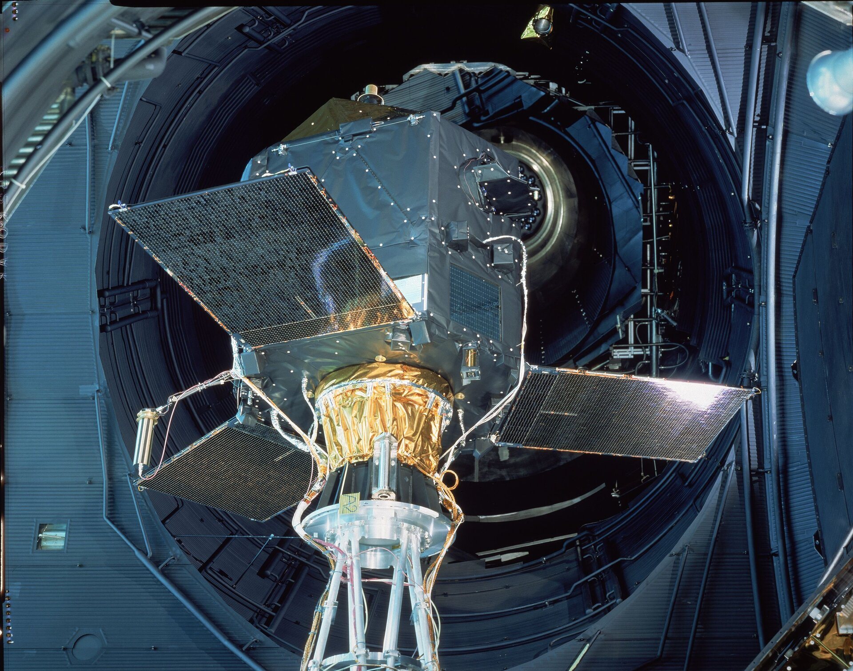
History of the Magnitude scale
Hipparchus (the ancient astronomer, not the telescope) divided the stars into 6 categories
The brightest were “1st magnitude” and the faintest were “6th magnitude” with the rest inbetween
This is why the scale is reversed with smaller numbers being brighter
This has been expanded in the modern version
Now we have negative numbers and bigger (fainter) numbers
It also applies to things other than stars
Like the Moon, planets, and galaxies

Slide 7
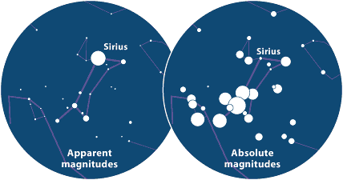
Apparent Magnitude vs Absolute Magnitude
Apparent magnitude depends on your distance to the object
Absolute magnitude assumes the same distance for all objects
It is a way to describe how bright it actually is (relative to other stars)
It is how bright the star would be if it was exactly 10 parsecs away

Slide 8
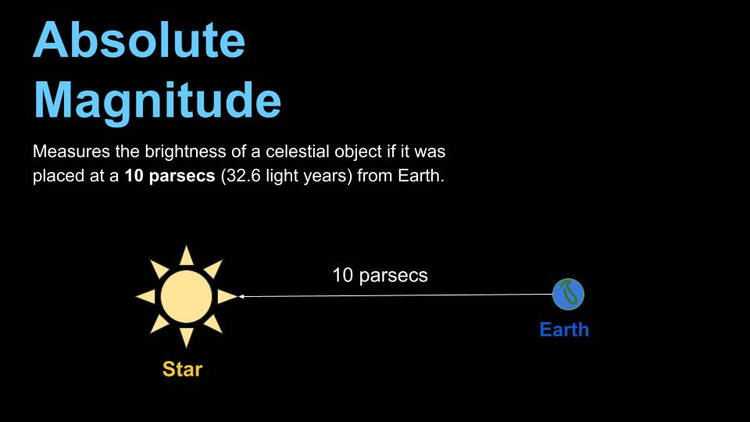
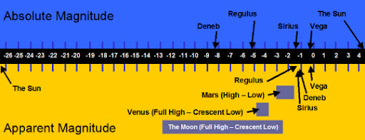
Absolute Magnitude
Absolute Magnitude still has these important details:
Inverse Scale
Smaller = Bigger
Logarithmic Scale
A difference of 1 magnitude is a difference of about 2.512 times in terms of brightness

Slide 9
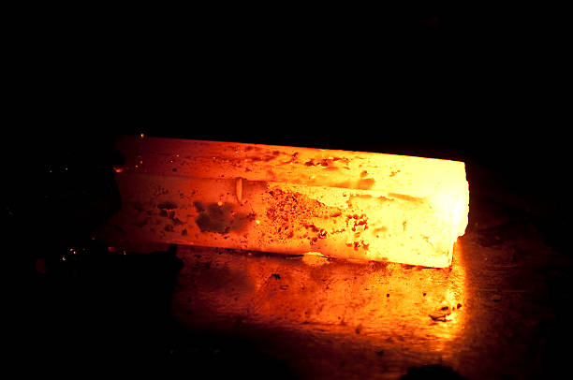
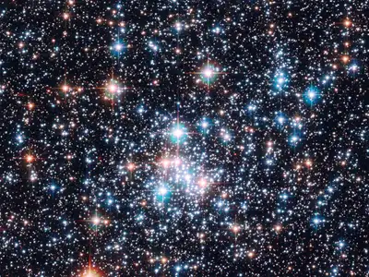
Star Color and Temperature
While spectral lines are impacted by composition (Spectroscopy Lab)…
In something as hot as a star, the color you see depends on the temperature
Think metal changing color as it heats up
In stars, red means a (relatively) cool temperature, and white/blue means a hot temperature
We’ll discuss more about what causes stars to have different temperatures in the upcoming HR Diagrams Lab
But for now, in simple terms, if we know the star’s color
→ We know its temperature, and if we know its temperature (and physical size)
→ We know how intrinsically bright (absolute magnitude) it is

Slide 10

Math Break
If we know both the absolute magnitude and the apparent magnitude, we can calculate the distance to the star
This equation is given in your lab script:
It shows the mathematical relationship between both magnitudes and distance
m = apparent magnitude
M = absolute magnitude
d = distance (in parsecs)
In your lab, you need to find the distance based on the magnitudes
So I will work through this on the board with you to solve for d

Slide 11
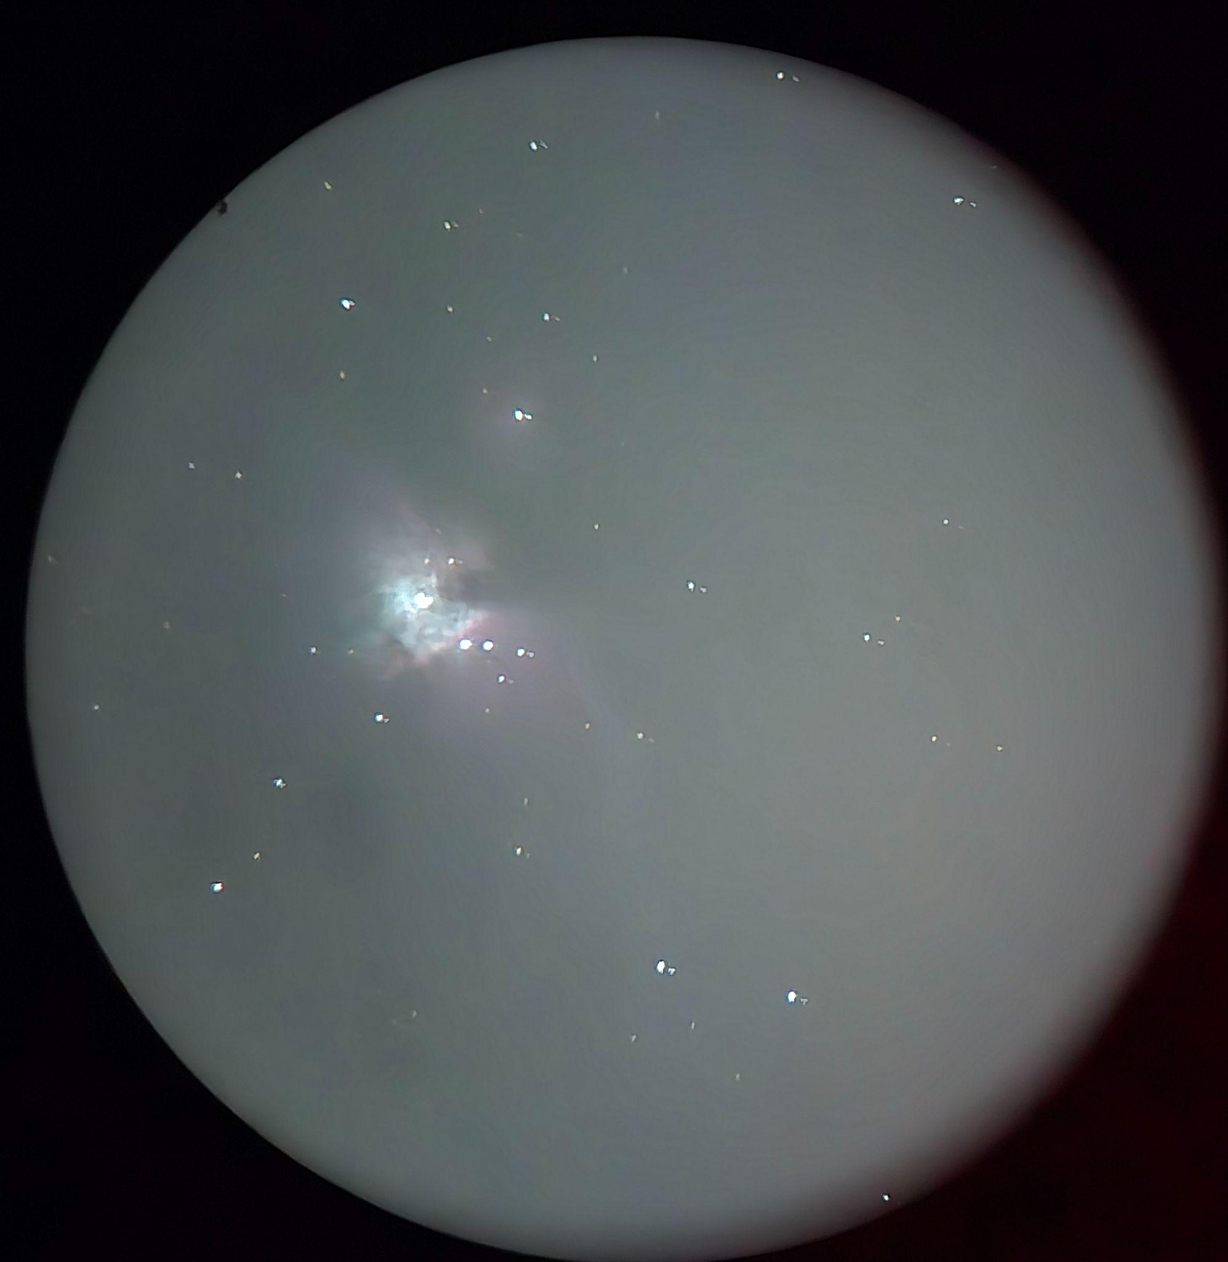
Today
Constellation sketch (similar to Intro to the Night Sky Lab)
Include cardinal directions and at least 8 stars
Use dot size to indicate star brightness
Estimate the apparent magnitude
We know the brightest stars are Sirius (-1.5) and Vega (0.0)
And we know the faintest visible stars are about 3.5 to 4 (normally closer to 7, but we have a lot of light pollution)
Page 5 gives a good walkthrough on how to do this
Do it again but with a telescope
This time the faintest stars will be roughly 7 magnitude
Use the internet/stargazing app to find the actual magnitudes instead of the Audubon Guide (You can use the Audubon guide if want though)
Question 4 - Use multiplication, not addition

